Slide 1

Mobile strategy
Lisa Grace
December 17, 2016

Slide 2
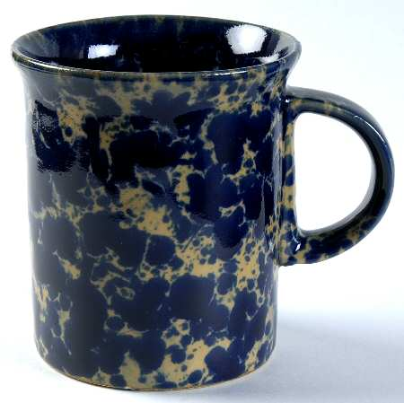
Introduction
Manufacture of unique Handcrafted Stoneware. It is privately owned. It has been operated by the founder and now his wife in the original plant in Bennington, Vermont since 1949. They have a retail store in Bennington and Burlington, Vermont and a growing online business. It is a regional business with a customer base composed of customers from the New England states along with New York and New Jersey.

Slide 3
Content
Market Landscape
Current Mobile Activity
Proposed Mobile Strategy (Mobile Moments)
Mobile Ad Campaign - Facebook and Google

Slide 4
Market Landscape

Slide 5
Target Audience and Strategy
Audience: -Current: 50+, collectors
          -New Target: 30-45, homeowners
Take opportunity to reach younger audience
Make enhancements on mobile and social media to reach younger audience:
  Increase email sign ups to generate new leads by making it easier to sign up on mobile for
  Develop a stronger social media presence by creating Pinterest page to promote home design accessories and utilize hashtags for Instagram
  Create preferred customer access by collecting opt ins for texting promo codes for discounts which will allow conversion tracking

Slide 6
Key Metrics
Monitor lead generation on mobile via text and email sign ups
CTR of mobile sponsored ad placements
Success of brand awareness using hashtags on social media

Slide 7
Competitors
Very strong social media presence on Pinterest and Instagram
Simon Pearce
    •24,933 likes on Facebook
    •8,604 followers on Instagram – 1,144 posts
    #simonpearce - 7K tags
    •1,097 followers on Pinterest – 11 boards/1k pins
    •2,444 followers on Twitter
Mackenzie-Childs
    •50,569 likes on Facebook
    •38,900 followers on Instagram – 725 posts
    #mackenziechilds - 25K tags
    •19,993 followers on Pinterest – 108 boards/5k pins
    •536 followers on Twitter

Slide 8
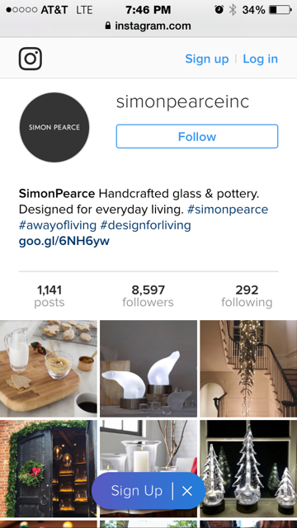
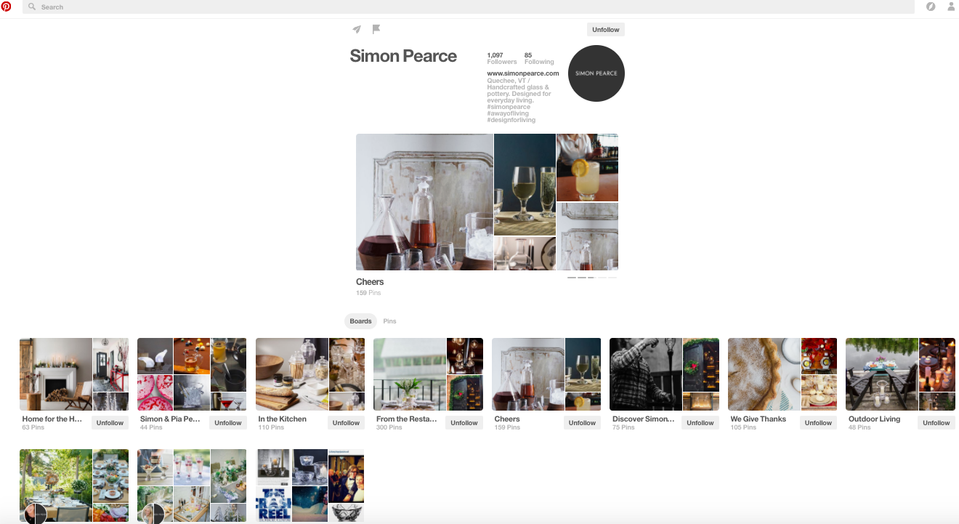
Simon Pearce Social Media

Slide 9
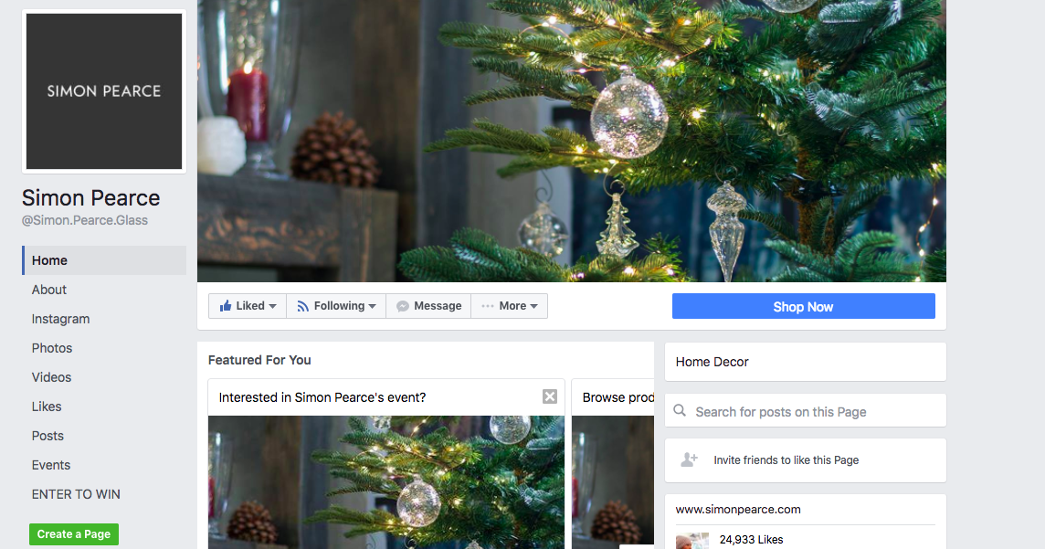
Simon Pearce Social Media (con’t)

Slide 10
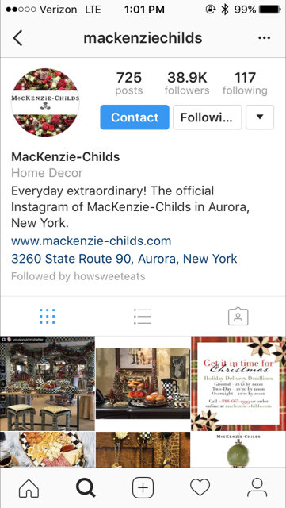
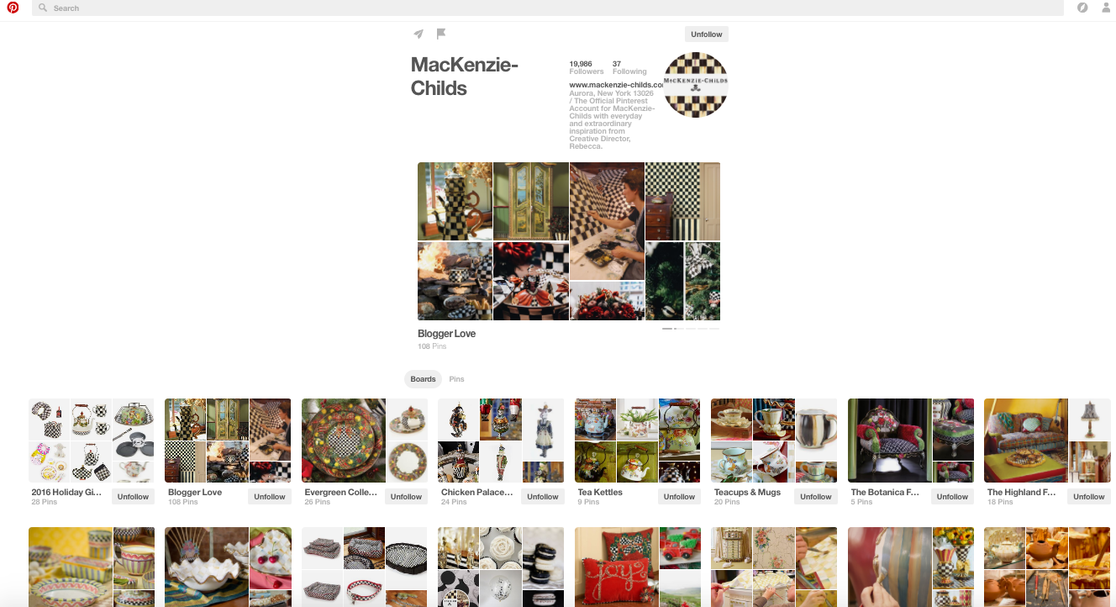
Mackenzie-Childs Social Media

Slide 11
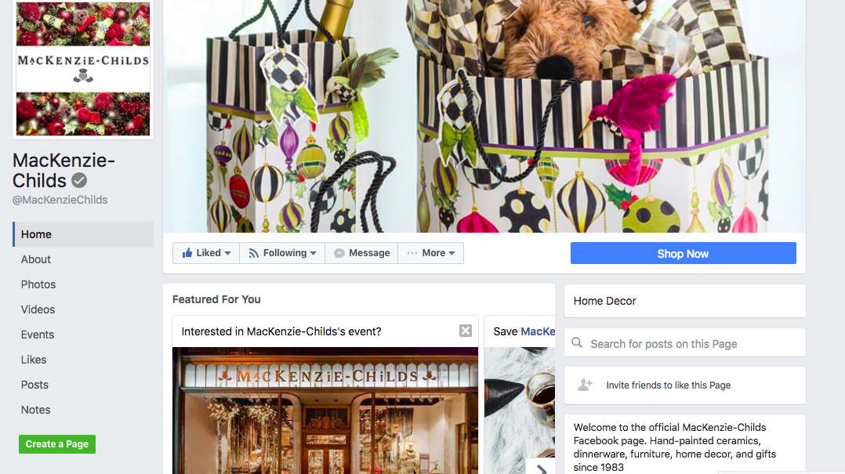
Mackenzie-Childs Social Media (con’t)

Slide 12
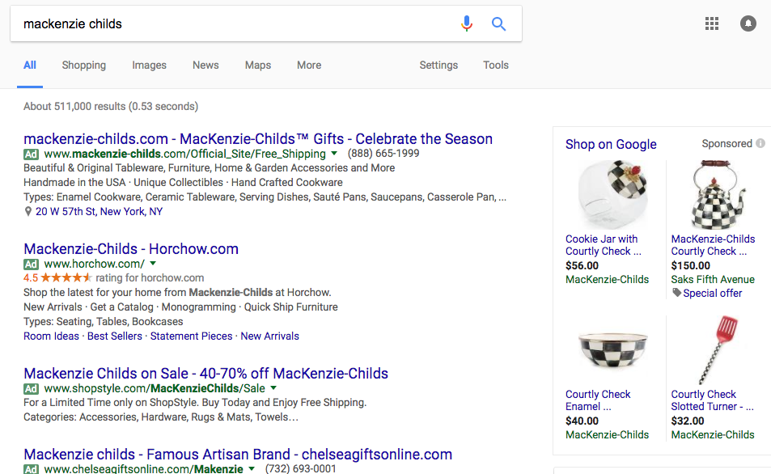
Competitor sponsored advertising – Online

Slide 13
Current Mobile Activity

Slide 14
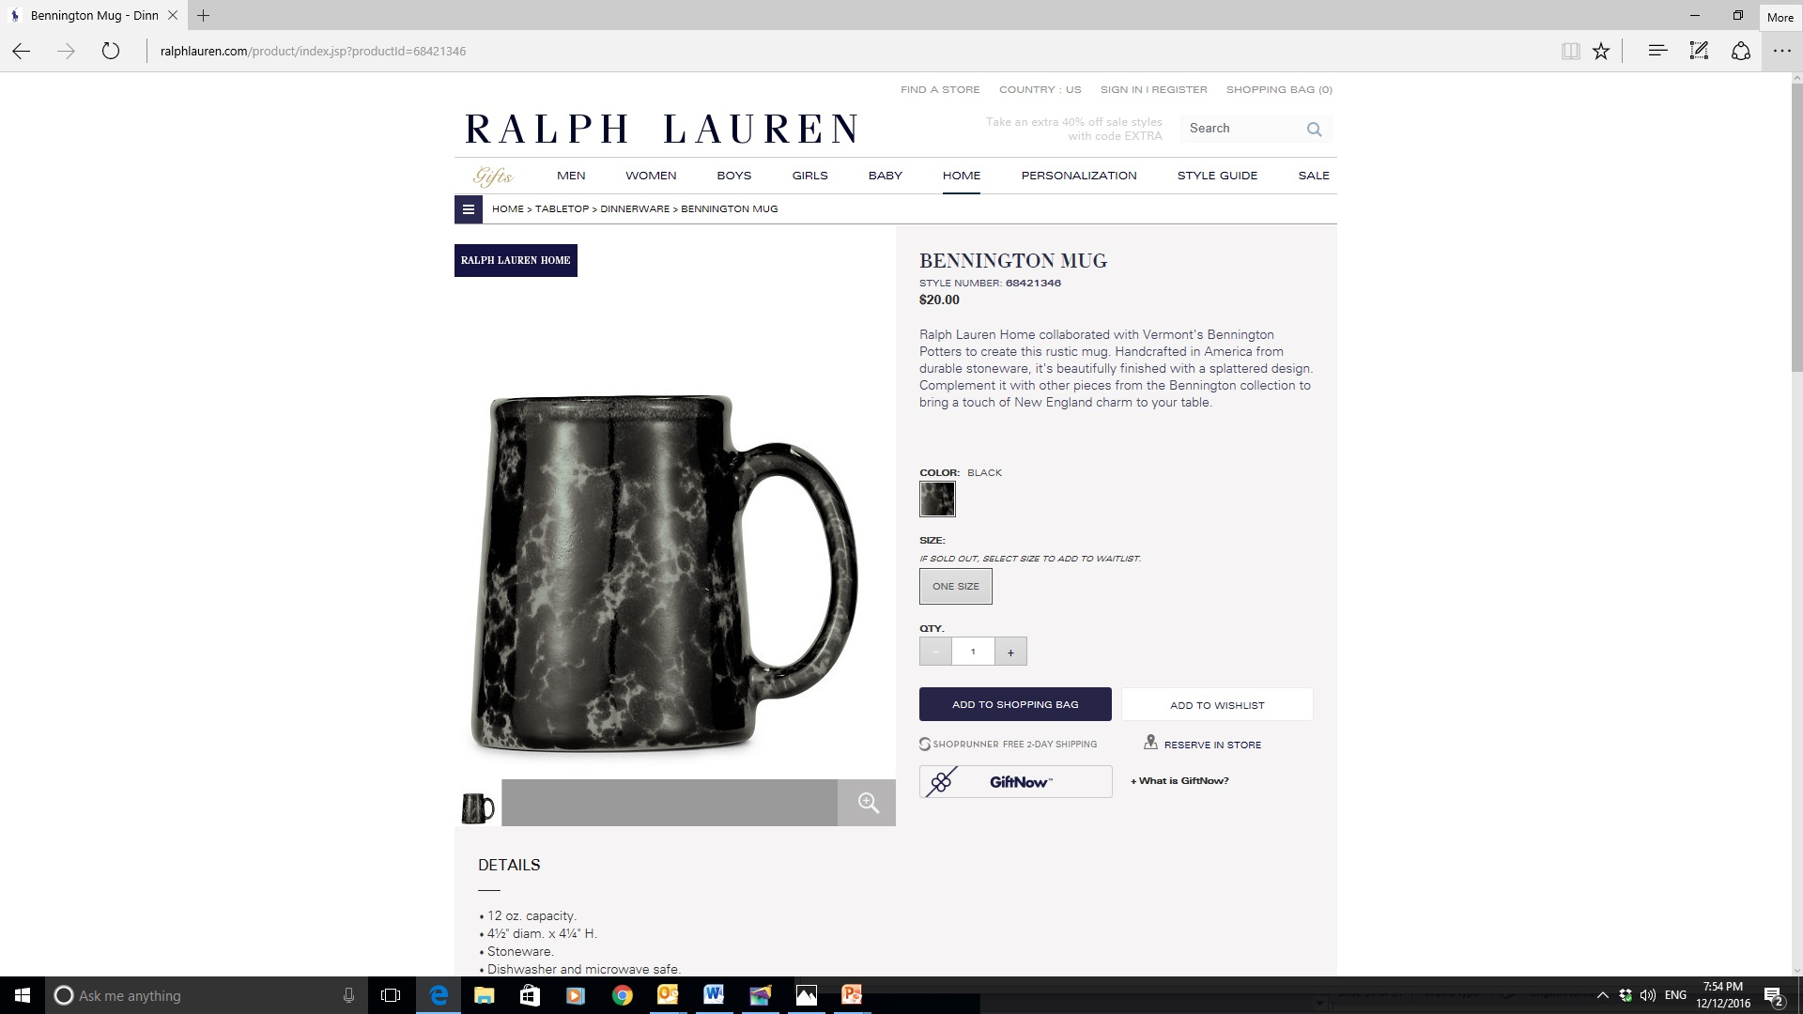
Influencers
Nurture and expand current relationship with retailer Ralph Lauren to promote collections using social media and email newsletters

Slide 15
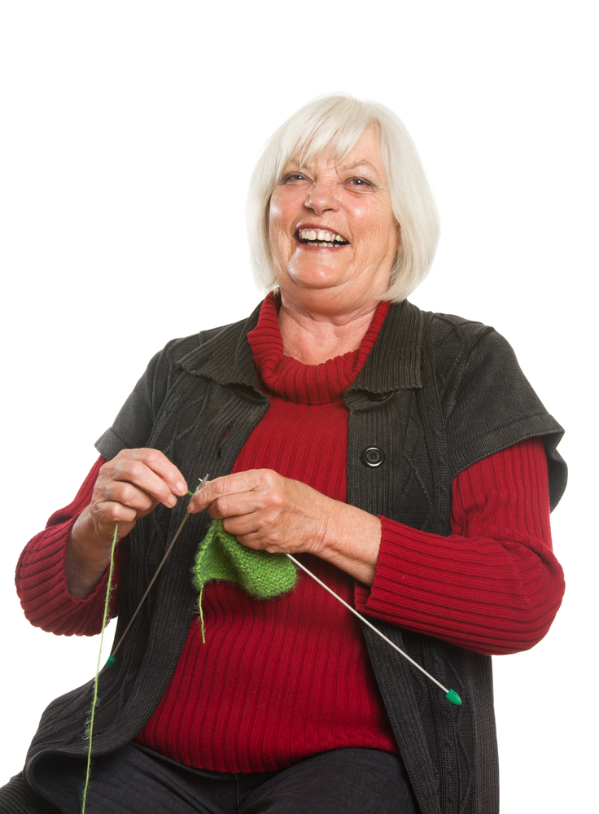
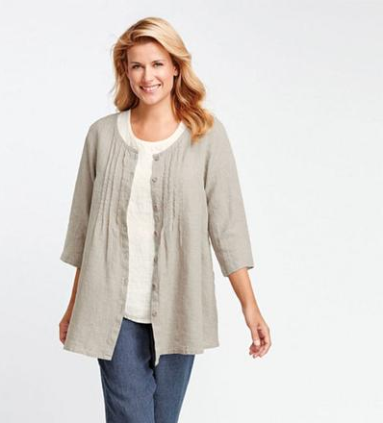
Customer Personas
Existing Customer
Female 50+ Collected Bennington potters for years. Has all the classic pieces. Likes to knit, garden, bake and drives a Subaru. Tends to be frugal.
New Customer
Female 30+ Buys sustainable and quality products. Active in social media, especially active on mobile platforms. Would like be considered understated wealthy or has resources. “can buy $30. mug” busy schedule with work and family. Drives Subaru or Range Rover, most likely Vegetarian, bakes and gardens.

Slide 16
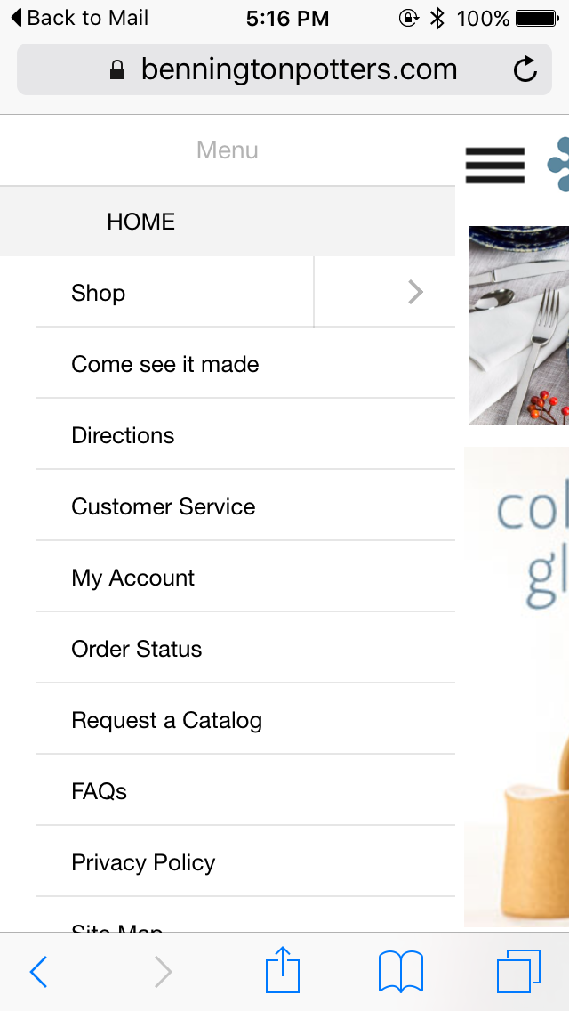
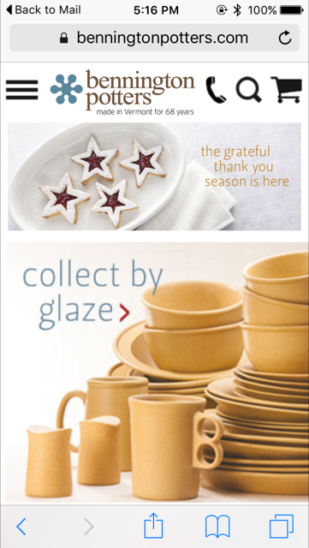
Mobile

Slide 17
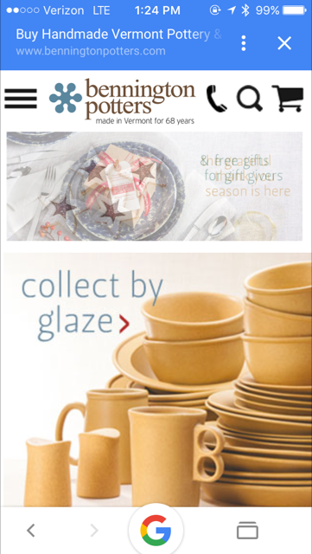
User Experience
Mobile designed site
Site has easy navigation for users
Poor email sign up promotion, located at the bottom of page
Recommendation: implement a chat feature for shoppers/consumers

Slide 18
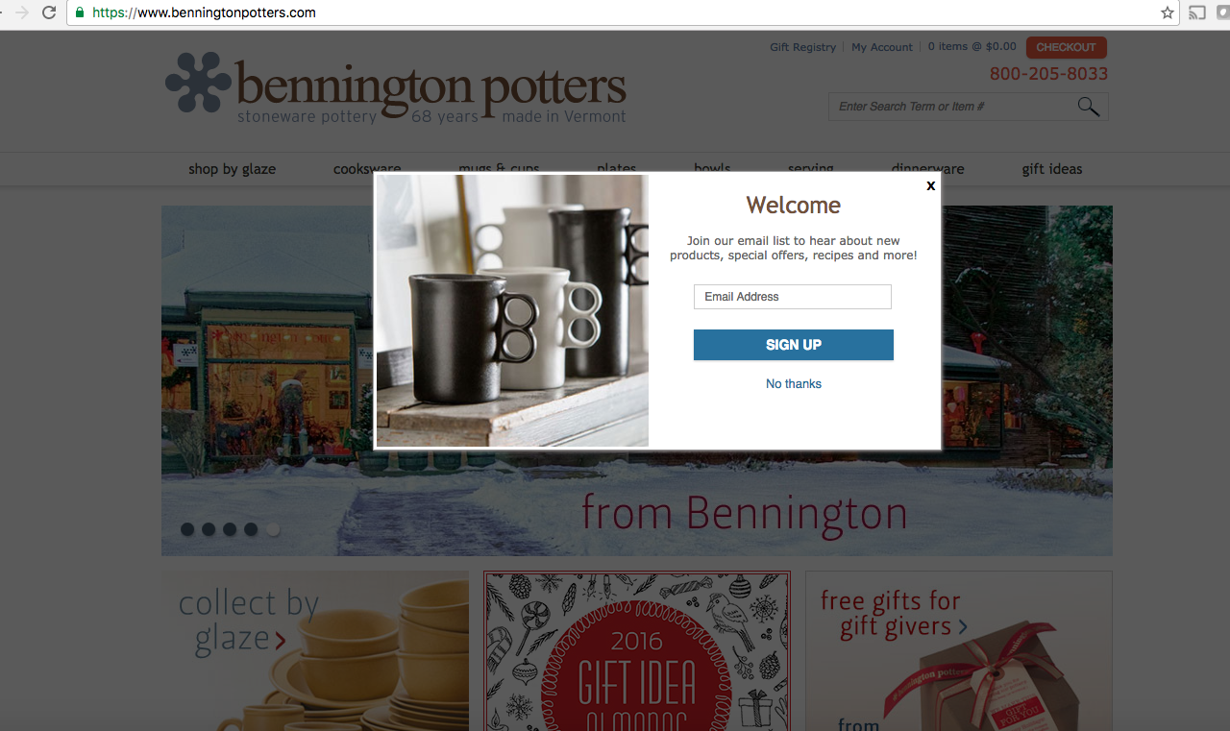
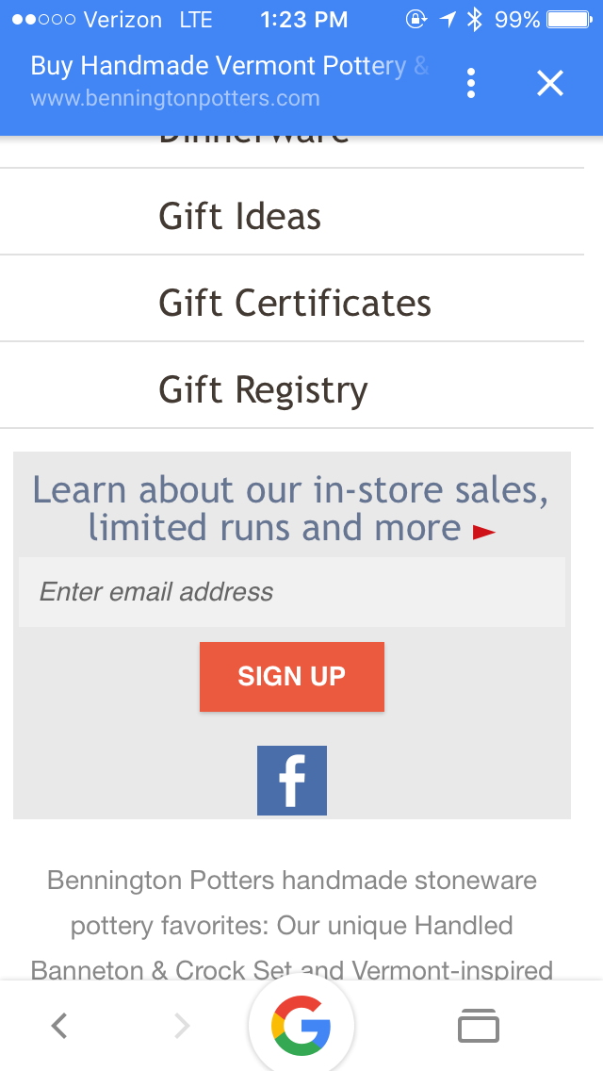
Email
Email sign up and marketing campaign stronger on desktop
  Consistent sale and promotion emails daily
Desktop
Mobile

Slide 19
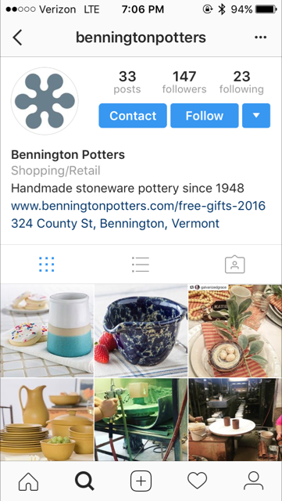
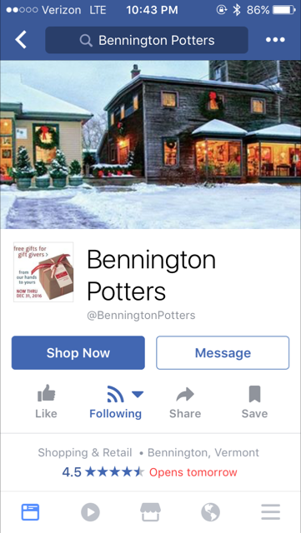
Bennington Potters Social Media
1,549 likes on Facebook
147 followers on Instagram
Instagram
Facebook

Slide 20
Bennington Potters has ground to gain
 | Simon Pearce | Mackenzie-Childs | Bennington Potters
Facebook Likes | 24,933 | 50,569 | 1,549
Instagram Followers | 8,604 (1,144 posts; 7,000 tags) | 38,900 (725 posts; 25,000 tags) | 147
Twitter Followers | 2,444 | 536 | N/A
Pinterest Followers | 1,097 (11 boards/k pins) | 19,993 (108 boards/5k pins) | N/A

Slide 21
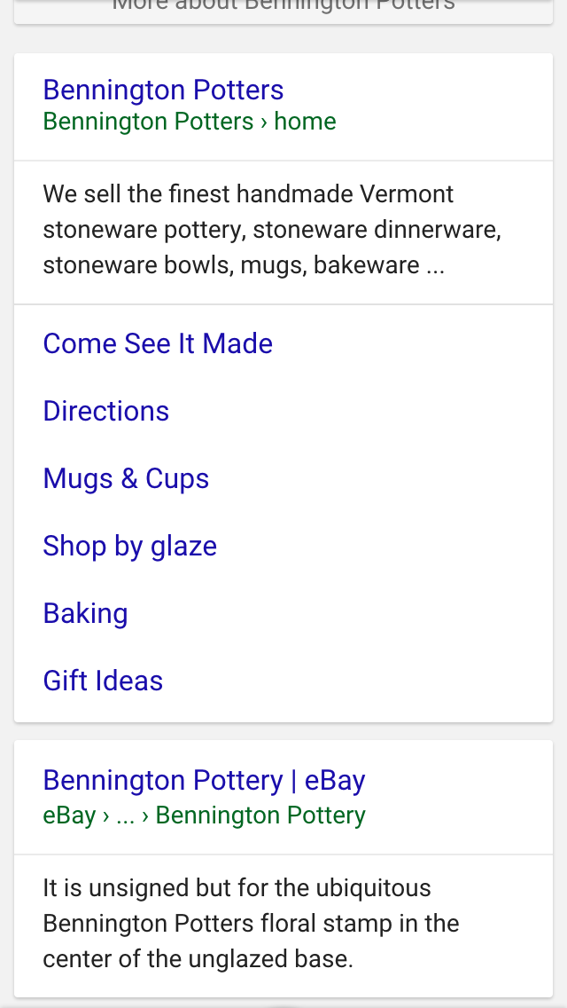
Advertising
No sponsored advertising
Feature best selling items in sponsored google ads
Improve SEO listing by allowing access for email sign up link to appear

Slide 22
Proposed Mobile Strategy
(Mobile Moments)

Slide 23
Mobile Moments Development Plan
Increase social media presence
  Generate stronger presence by using identified hashtags when posting on Instagram and Pinterest
  Implement campaign on social media including customers generated video and photo posts using Bennington pottery (i.e. #mybenningtonpottery hashtag)
Implement sponsored advertising
Promote brand awareness from influencers via social media and blogs
Partner with businesses in community for affiliate marketing program:
  Local/regional restaurants & gift shops, local tourism boards and regional home decorating stores.

Slide 24
Social Media
Hashtags to utilize for social media pages
#gifts 8 million
#bennington 26K
#benningtonpottery 363k
#uniquegifts 160K
#holidayshopping 422K
#freeshipping 1.7 million
#madeinvermont 17K
#pottery 1.9 million
#ceramic 2.5 million
#stoneware 213K
#madeinamerica 1 million
#vermont 1.8 million
#mybenningtonpottery campaign (promote)

Slide 25
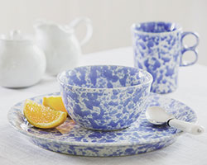
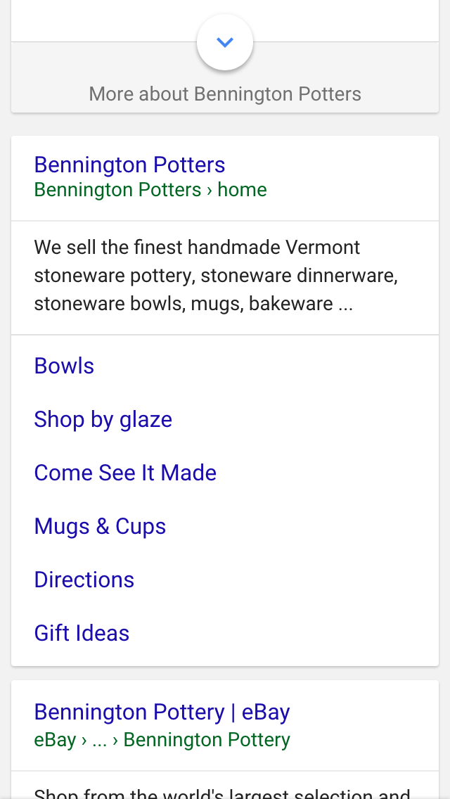
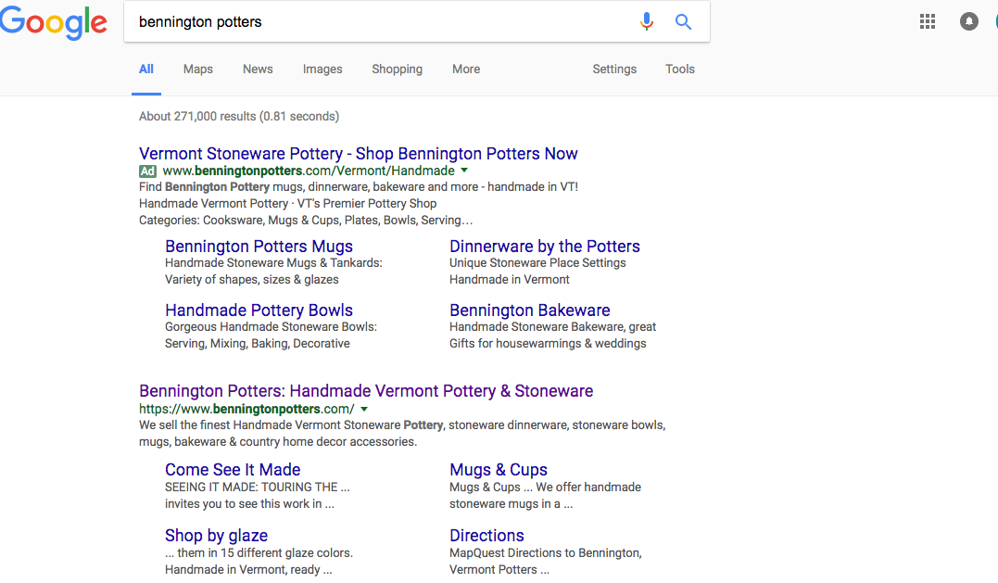
Sponsored advertising
Classic Dinnerware 3-Piece Place Setting
$66.00–$79.00
www.benningtonpotters.com

Slide 26
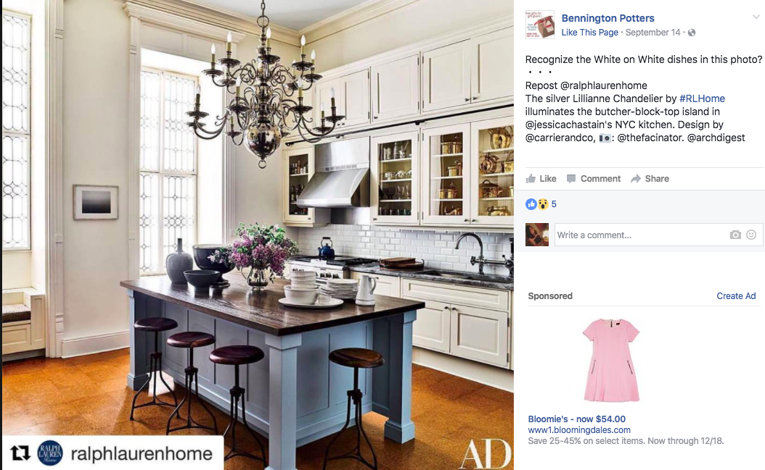
Promote brand recognition via social media and email marketing:
Dinnerware featured in Architectural Digest

Slide 27
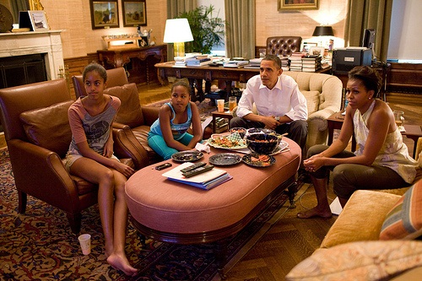
White House selected ceramic dinnerware

Slide 28
Mobile Ad Campaign
Facebook and Google

Slide 29
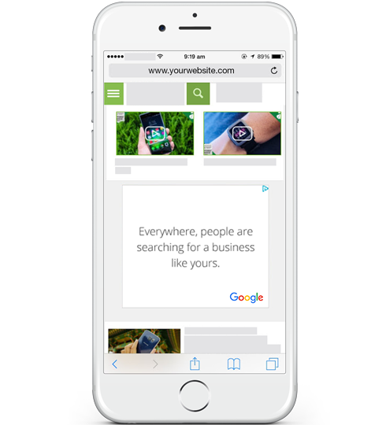
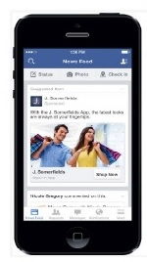
Proposed Mobile Ad Campaign:
Utilizing Facebook and Google

Slide 30
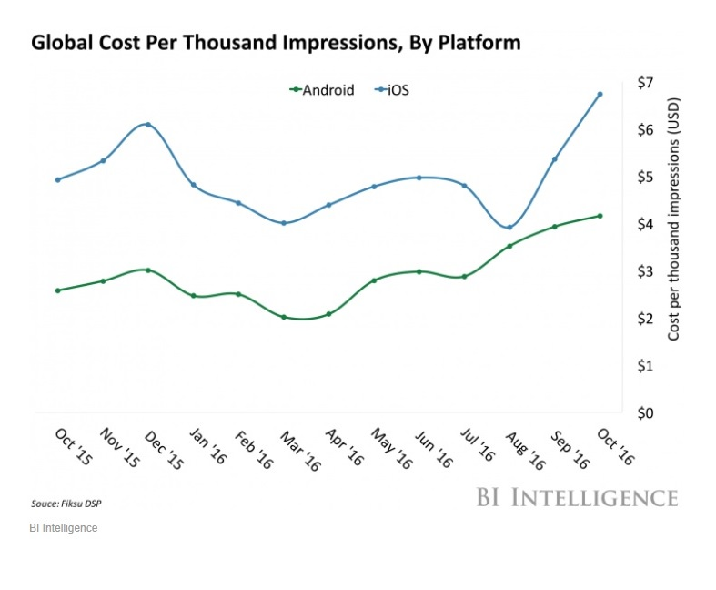
Cost Per 1000 Impressions
Proposed Budget
$500. Month Facebook for 6 months
$500. Month Google Adwords

Slide 31
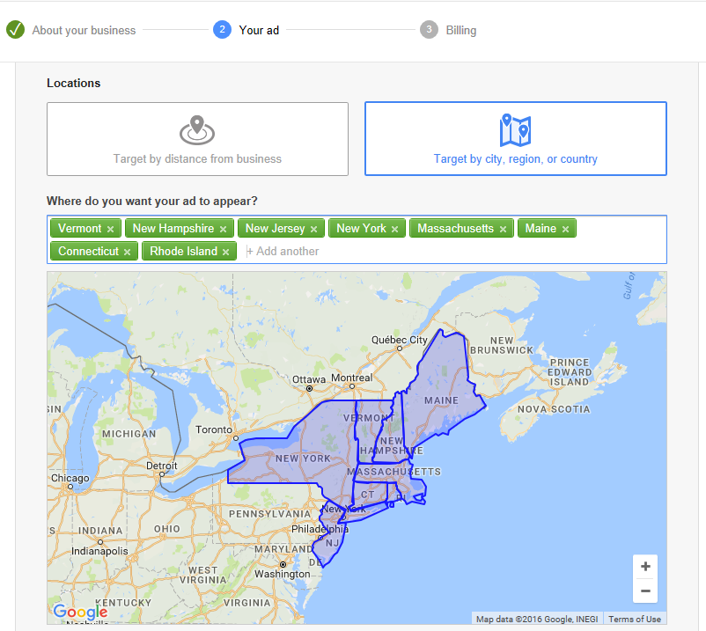
Geographical Google Target:
Connecticut
Maine
Massachusetts
New Hampshire
New Jersey
New York
Rhode Island
Vermont

Slide 32
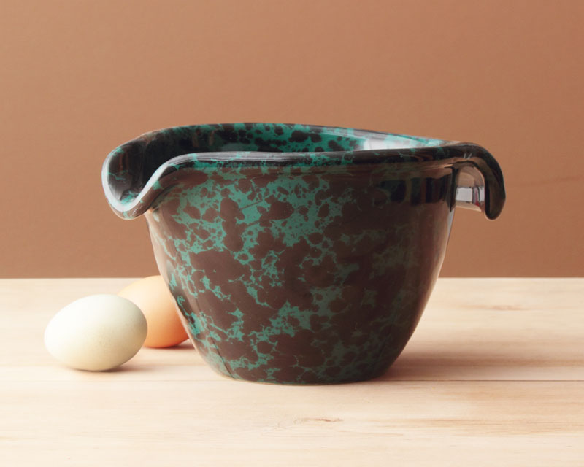
Key Words for Mobile Display Campaign
Pottery
Stoneware
Hand made Pottery
Pottery Barn
Gourmet Bakeware
Organic products
Vermont Products
Simon Pearce pottery
McKenzie-Childs
Subaru
Sustainable products
Bennington Vermont
Vermont Foliage
Vermont Skiing

Slide 33
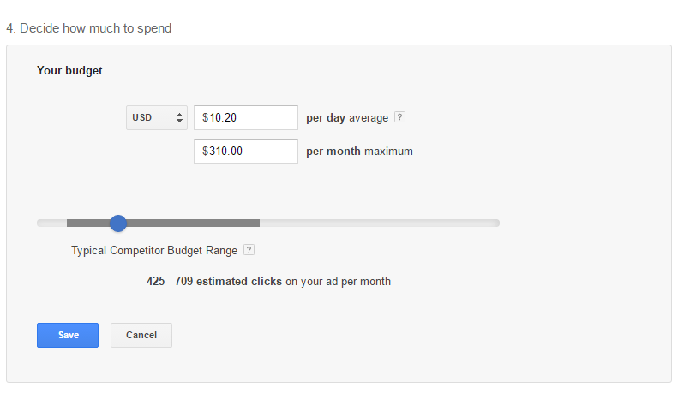
Google Ad Words

Slide 34
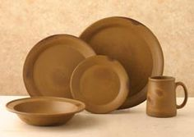
Conversions
New likes on Facebook as well as followers on Instagram and Pinterest
Sign up for Newsletter
Increased On-Line Sales
Monitor engagement of clickable “On-Line Specialist” feature
Increased Traffic and Sales at two retail locations
Track and monitor hashtags usage i.e. #tavernware, #blueagate from consumers and followers

Slide 35
Summary
Key competitors are significantly outpacing Bennington Potters in key mobile activity metrics
Bennington Potters mobile strategy provides room for tremendous growth opportunities
Creating Mobile Moments is key in driving customer conversions and creating a new online brand awareness
Effective use of existing platforms such as Google and Facebook will achieve outreach to new mobile customer segment

